Slide 1
VA.gov Vet Centers District 2 Kickoff
Dave Conlon, Senior Director Digital Service at VA
Office of the CTO – Digital Experience

Slide 2
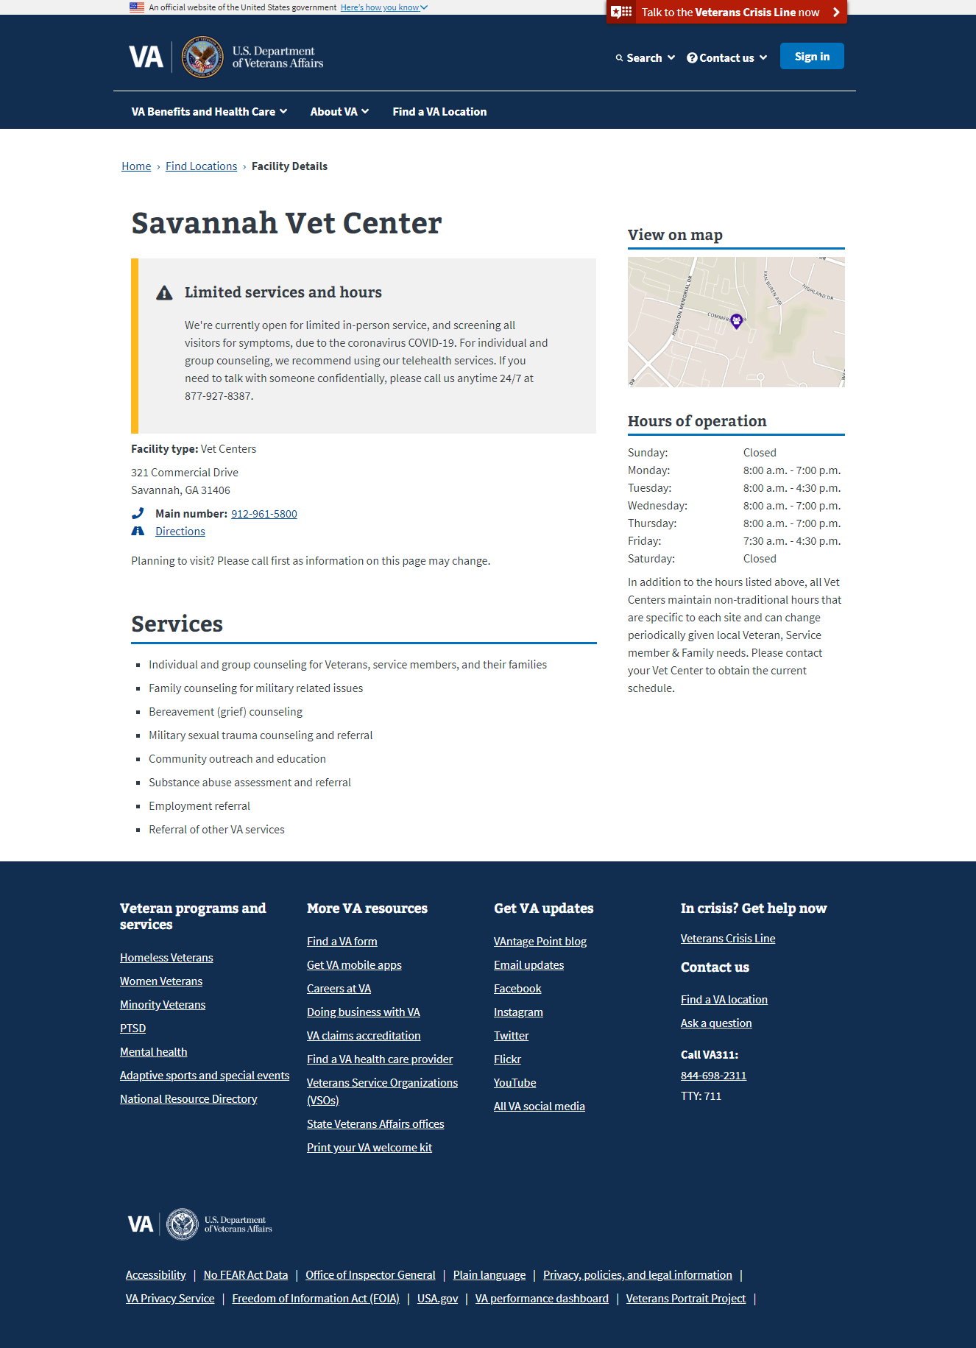
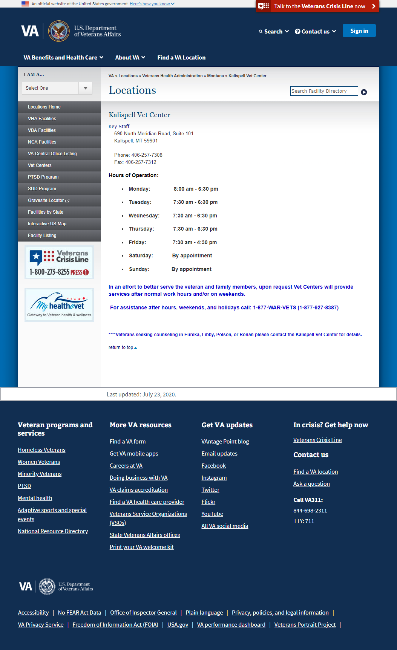
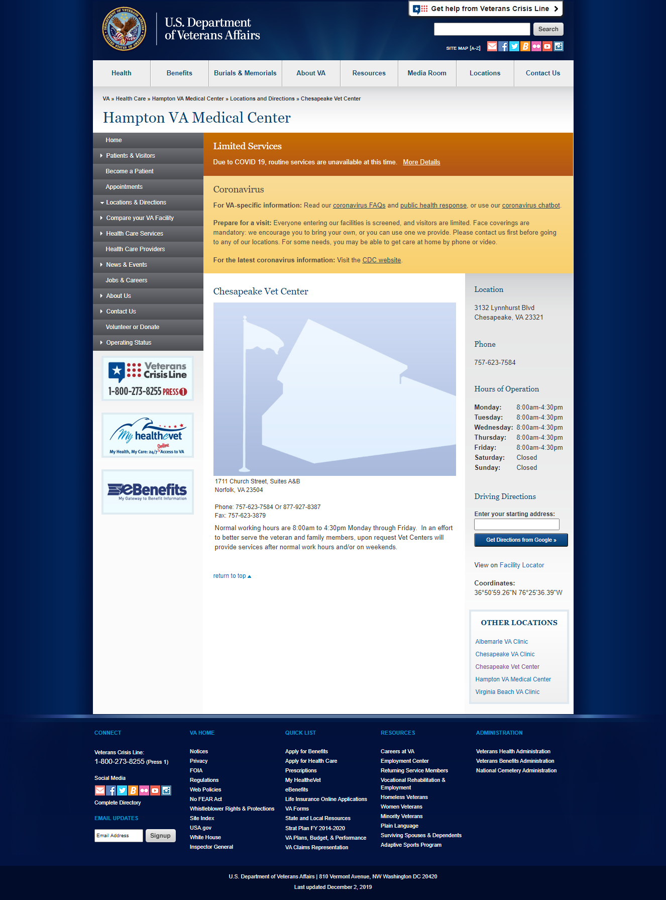
Vet Centers: Current state
VA.gov Facility Locator Detail Pages exist for all Vet Centers with entries in the Lighthouse Facilities API (Facility single-source-of-truth).
Legacy Facility Locator also has detail pages that need to be deprecated.
A handful of Vet Centers exist in TeamSite CMS as part of VHA Medical Center websites.
Notes:
The current state doesn’t really have much of a single source of truth. What we want to do is to re-align these different web presences into one tested, veteran-facing application that can keep the information most important to veterans accurate and timely.

Slide 3
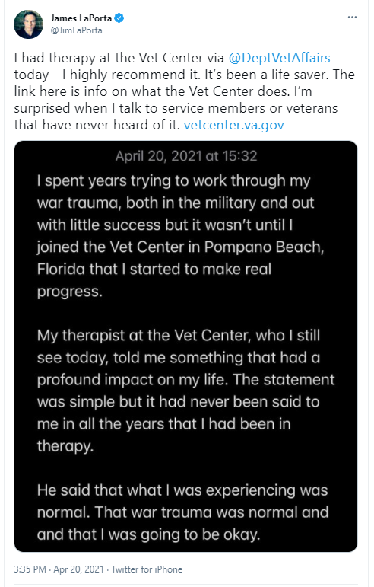
Opportunity
There is a general lack of awareness about Vet Centers. They are often confused with VA Medical Centers or Clinics and the difference between them is important.
Vet Center clients prefer the personalized approach to mental health care. Vet Centers excel at removing the physical and emotional barriers to care and help Vets feel deeply understood.
Veterans look for themselves on the page. They prefer to see symptoms over diagnoses and value representation of diverse populations. Women are drawn to the Women veteran care accordion.
Although service offerings are consistent nationally, Vet Centers have great autonomy in how services are delivered.
Vet Centers have a powerful geographic reach which can be difficult to communicate.
Notes:
Our Veteran research reinforced that Veterans often don’t know about Vet Centers. Some think that they do but conflate them with clinics.
What we heard over and over, and has been seen in tweets and on reddit and other sources is that Vet Centers are the ‘hidden jewel’ of VA. There’s almost the perception that they are not VA because they are so warm, friendly, and helpful.
In our prototype testing Veterans look to self-identify with words on the page in terms of symptoms, problems that they have, or in areas such as gender, race, or ethnicity. We saw this as part of other facility testing as well.
Because of the expertise and passion of the staff _how_ we deliver services to veterans can vary – especially in terms of the different support groups.
One of the most important areas we learned is that Community Access Points are currently unknown and unsearchable, and we need to make it clearer to Veterans that we are closer to them than they may know.

Slide 4
Our process: User-centered design
Who we talked with:
5 Vet Center outreach specialists
Moderated research sessions with 35 Veterans
Unmoderated research with 40+ Veterans
What we did:
Learn Vet Center locations, services, and staff
Learn how Veterans understand (or are confused by) VA services
Prototype evaluations
Notes:
So what did we do? We talked to a whole bunch of folks – most especially Veterans – so that we can understand Vet Centers and convey this information in a way that makes sense to Veterans.
This included creating a prototype website and evaluating that design through usability testing with Veterans.

Slide 5
Vet Center product design
Based upon this Veteran research, we have designed a Minimum Viable Product (MVP) using existing components from the VA.gov Platform.
Page content will emphasize the warm, confidential and non-clinical environment.
Services will be grouped to emphasize Counseling and Referral categories and use ”support” and “care” over “treatment” to reinforce the non-clinical setting.
Photos and “Prepare for your visit” details will help Veterans anticipate the visit and communicate the location’s size and setting.
“Satellite locations” will be used to communicate the relationship between the types of locations and set expectations about service offerings.
Field staff will add content to services descriptions to convey ways in which the care is delivered at that specific Vet Center.
Services will convey a “just call, we’ll help” feeling to relieve eligibility concerns
Future research will help us to continue to iterate on the product so that we can meet Veterans where they are at and align the product with changing Veteran expectations.
Notes:
We designed a very thin product.
What we didn’t want to do was create something that was “surprise look at how much work we gave you!” We need a light-weight way to collect this information and surface it to veterans but in a way with minimal impact to the field so that we don’t get in the way of the amazing work our field folks do for Veterans.
And we wanted to ensure the “humanization” of VA – especially in terms of Vet Centers. We don’t want a cold, clinical feel – if anything we want the great reputation of Vet Centers to elevate the rest of VA. We wanted to provide a way to both create standards as well as convey the personal, unique flavor that each of you provides are your unique Vet Centers. I’ll demonstrate in a moment how we used standardized service names and national descriptions to talk about services Vet Centers in general offer, but how we look to you to add to those national descriptions with how your unique Vet Center delivers those services.
We want to elevate those Community Access Points and we want to express that warm, friendly service delivery capability.
Lastly, we want to get something out there—an MVP-- so that we can make more data-based decisions on analytics. The great thing about the web is that it is malleable, and through user-centered design we have the hypotheses that we test. I love being right but I love even more being wrong and being able to make something better quickly.

Slide 6
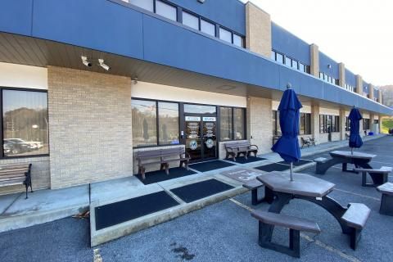
Demo:
Morgantown Vet Center

Slide 7
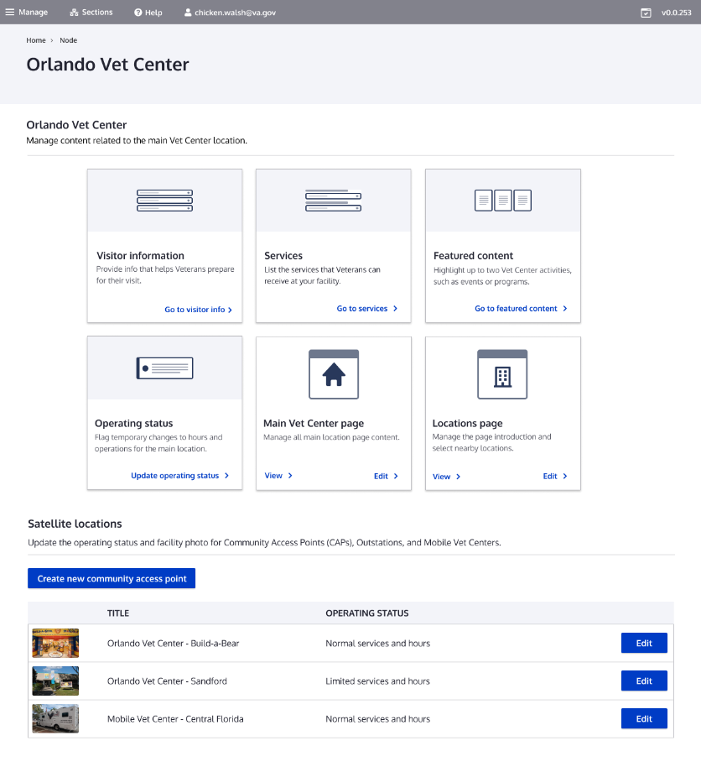
Vet Center editor dashboard in Drupal
Provides quick access to top tasks, so that busy Vet Center editors can get their job done efficiently.
Notes:
The other thing is that we wanted to ensure timely, accurate data and not get in the way of the ‘real work’ that Vet Centers do.
We learned that most Vet Center staff have neither experience working on the web, or a lot of time to devote to it. This is part of their job description that says “and other duties”.
So we build in the Drupal CMS a dashboard that provides a single-click access to the top tasks for Vet Center editors, to help them get their job done quickly and efficiently. This is a design that we tested with Vet Center editors in February, and will be training them to use. Our hypothesis is that it will be intuitive enough that training will needs will be minimal.
But again, we can iterate

Slide 8
Creation Process

Slide 9
How the process works: Learn by doing with support
Tasks for Vet Center Outreach Coordinators/Directors
How Office of the CTO and RCS Central Office support you
Photos of your Vet Center, Outstations, CAPs, and Mobile Vet Centers
Take the self-service training on the Vet Center Drupal product
Gather content and data and complete a workbook/content deck
Familiarize yourself with the key areas of the VA.gov Design System content style guide
Load your content into Drupal
Photo guidelines
On-Demand video training and exercises
Workbook/content deck with examples and guidance
Examples from Vet Centers in production
Weekly Office hours for drop-in help
CMS Knowledgebase “How to” articles
Drupal help desk
Notes:
Take photos of your Vet Center, Outstations, CAPs, and Mobile Vet Centers. These don’t need to be professional photos, you can take one with your mobile phone. We’ll be providing you specific guidelines but the nature of these photos are to help Veterans understand what your Vet Center looks like so that they know what to look for when they are arriving from the street/parking lot, etc.
Take the training. Should only take a little over an hour to complete.
Gather content and data to complete a workbook/content deck. This is a word doc to help you organize content before you enter it into Drupal. This will help you to collaborate and Work with counselors and staff to determine the local details for how services are delivered at your Vet Center. Part of this workbook will also give you pointers to the VA.gov Design System content style guide so that you can understand how to write content for VA.gov.
Also we encourage plagiarism. (just be sure to update the Vet Center name in the content) We currently have 165 Vet Centers in production for you to take a look at and get ideas/copy content from. They are a great resource and time-savings.
We will have weekly office hours for drop in help to work through some of the questions you may have.
We have a knowledge base of how to articles in addition to those on-demand videos.
And we have a Drupal Help Desk if you have problems using Drupal – these folks are available 8a – 8p ET and are frequently present at those Office hour drop in sessions.
Speaking of we recently completed our VAMC effort so that we are able to have more help sessions for District 2 than we have in the past so we’re really excited about that.

Slide 10
District 2 timeline
Milestone | Dates
Kickoff Meetings | March 2nd and March 3rd
Resources email sent to Vet Center Directors and Outreach Specialists that includes: Link to Kickoff meeting video recordings (for those that missed us!) Timeline Workbook/content deck and links to Content Style Guide Training Video links and Instructions on how to access a training environment Information on how to access the CMS Production environment so you can populate content on your site | March 3rd shortly after the last presentation
Open office hours for help | Workbook review Option #1: Wednesday March 9 at 1:00 PM ET Option #2: Thursday March 10 at 10:00 AM ET Weekly office hours TBD
Deadline to complete training and load all content into Drupal | Proposed: Friday April 15, 2022, Close of Business
Review/Feedback/Launch by RCS Central Office, OCTODE | Ongoing
Notes:
OK So let’s talk Timeline
We have our kickoff meetings happening today and tomorrow.
After tomorrow’s presentation you’ll be receiving an email from one of our team members that will include: Link to Kickoff meeting video recordings (for those that missed us!)
Timeline
Workbook/content deck and links to Content Style Guide
Training Video links and Instructions on how to access a training environment
Information on how to access the CMS Production environment so you can populate content on your site
Content deck – word document that will help you to gather your thoughts and help you create your content together before you put it on the web. It also includes examples/best practices.
We also are giving you links to the VA.gov Content Style Guide as well as a document that explains the intent behind each of the fields that you are filling out.
All of our training is self-service videos to watch and do exercises with. We estimate that the videos and exercises can be completed in a little over one hour.
The deadline to complete all of the training and load content into Drupal is Friday April 15, 2022. This is 6 weeks from Friday and on-par with what the other districts have had for a deadline.
This is a deadline – in the past we’ve had some real go-getters who have jumped in and completed all of the work very quickly and we encourage folks to not wait until the last minute.
Because once the content has been submitted we’ll be working with RCS Central office to conduct a final review, work with you for any tweaks you need to make, and then we will publish the sites and hand the reigns over to you!

Slide 11
Vet Center Product Team
Readjustment Counseling Service Central Office Team
Product Development Team
Dave Conlon – Product Owner
Michelle Middaugh – Product Manager, Ad Hoc
Nick Osmanski - Designer/Researcher, Amida
Dave Alan Sukharan– Designer/Researcher, Ad Hoc
Napoleon Kernessant – Front End Developer, GovernmentCIO
Lance Sanchez – Back End Developer, Government CIO
Content Support Team
Stan Gardner – Product Manager, Government CIO
Lisa Trombley – Business Analyst, Government CIO
Larry West – Digital Content Support, Government CIO
Ron Tafoya – Digital Content Support, Government CIO
Michelle Middaugh – Product Manager, Ad Hoc
RCS Central Office Team
Jessica Schiefer - RCS Communications Officer, VHA
Barbara Kuhn, RCS Communications

Slide 12
Facilities vision
Facility-based: Veterans can find all VA and in-VA network facilities based on their current geographical location or another starting/preferred location
Service-based: Veterans can find locations of all VA services based on their current geographical location or another starting/preferred location
Notes:
Locations of VA Facilities are important to Veterans. This is where they get the majority of “things” or services but, more really they associate VA with a physical location – “My VA” – which could be a Hospital or Clinic, Vet Center, or Benefits location.
Our physical locations, and most definitely our staff, help to humanize VA and not the a gigantic, monolithic organization with a lot of unhelpful bureaucracy.
We heard that over and over in our veteran research for all of our facilities but in particular our Veteran research for Vet Centers.
It’s important for us to know where we are located, what services we offer, and be able to convey that in a language that aligns with the Veteran’s own language.
It’s also important to have a single source of veteran-facing truth for that because we are creating an ecosystem for these things. We also need to do a better job in conveying these services to Veterans. We have a tendency to force veterans to know our organizational structure in order to get the help they need rather than allowing the veteran to start with their problem.
We want to allow veterans to be able to search for “Depression” or “Trouble sleeping” so that we can get that Veteran the help that he or she needs as close to where they are – whether that be in a nearby clinic, vet center, or even through the computer or mobile device that they are using to access VA.gov.
We want this information available not just for our websites but make it available to other, future applications – whether that be a scheduling application or a mobile app.

Slide 13
District 2 timeline
Milestone | Dates
Kickoff Meetings | March 2nd and March 3rd
Resources email sent to Vet Center Directors and Outreach Specialists that includes: Link to Kickoff meeting video recordings (for those that missed us!) Timeline Workbook/content deck and links to Content Style Guide Training Video links and Instructions on how to access a training environment Information on how to access the CMS Production environment so you can populate content on your site | March 3rd shortly after the last presentation
Open office hours for help | Workbook review Option #1: Wednesday March 9 at 1:00 PM ET Option #2: Thursday March 10 at 10:00 AM ET Weekly office hours TBD
Deadline to complete training and load all content into Drupal | Proposed: Friday April 15, 2022, Close of Business
Review/Feedback/Launch by RCS Central Office, OCTODE | Ongoing
Notes:
Content deck – word document that will help you to gather your thoughts and help you create your content together before you put it on the web. It also includes examples/best practices.
We also are giving you links to the VA.gov Content Style Guide as well as a document that explains the intent behind each of the fields that you are filling out.
All of our training is self-service videos to watch and do exercises with. We estimate that the videos and exercises can be completed in a little over one hour.

